Slide 1
Lisa Förlin, Lund, Sweden
1
Devoted to inspiringly sharing my passion for improving ourselves from an
environmental point of view, and sharing my aim to sustain the environment
Studies and work
Environmental issues

Slide 2
Studies – Lund University
2
Environmental Engineering, Lund Institute of Technology, Lund University
Engineering sciences
Additionally covering amongst others – Aquatic ecology, Geology, Water chemistry, and Microbiology

Slide 3
Studies – Seattle, University of Washington
3
https://www.washington.edu/
Exchange student, Seattle
    Profounding my knowledge and to get the experience
    of studying abroad
Courses
    Stream and river ecology
    Fluvial Geomorphology
      how water movement affects surrounding land and how the surrounding land affects the flow of the water
    Biogeochemistry
      the flow of elements between soil, water, air, and biomass. In this case it mostly does not include pollutants, however they “travel” with the same processes.

Slide 4
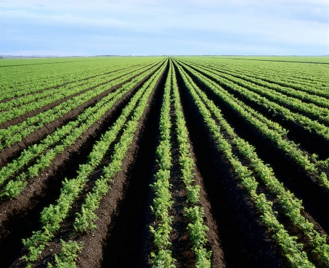
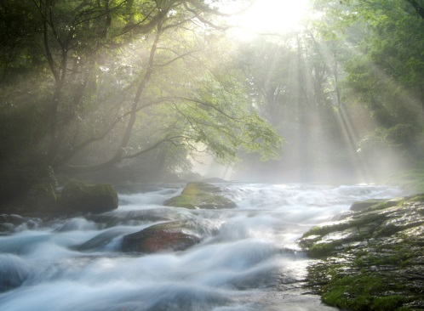
Studies – the end
4
→ Water – constructing wetlands, restoration of streams and rivers
→ Graduation

Slide 5
To work as a consultant
5
We contact or are contacted by
    Companies
    Municipalities
    Organizations
We are hired to perform the work that they don’t have enough staff for, or knowledge of, to complete themselves

Slide 6

WSP – In short
6
Mission: “Be a solution-driven advisor with outstanding expertise”
    Building: houses, roads, railways, bridges
    Project management
    Environmental management
    Soil and water projects
15,000 employees, > 300 offices, 35 countries

Slide 7
My work – it’s profitable to clean the environment
7
Water sources /water bodies
  Investigate the source of feces pollution to a beach
      → We want clean beaches to attract tourists
  Water chemistry of surface waters
      → Present its possibilities as a source for drinking water
Contaminated land
  Why we do what we do:
      Selling properties – clean soil /at least investigated
  Ex. Västra Hamnen Malmö – heavy industries, lots of soil and water pollution
  → clean(er): private housing, office buildings, beaches, and parks thanks to brave politicians and building companies

Slide 8
Contaminated land project
8
Preparation
    Maps old and new → To know if there was previous
    activity that might have caused pollution
    contacting - land owners, - municipality etc
    What pollutants is there a risk to find?
    Field work
      Collect samples
      Make measurements
      Send samples for analysis
    Reporting
      Summarize analysis results
      Suggest measures to be taken
      Write a report
Preparation
Field work
Reporting

Slide 9
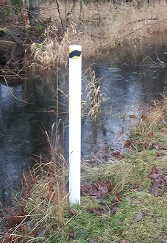
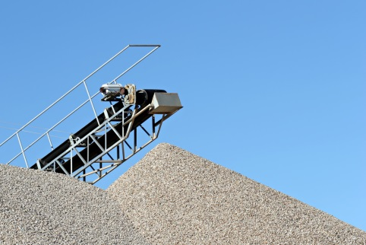

Remediation of polluted soil
9
Spills of hydrocarbons, old barrels, wood impregnations
    Polluted soil can be treated → Expensive
    Excavate Ex-situ treatment In-situ treatment
          →
            - Separate/Washing - Biological/chemical
            - Landfill
    Routines to prevent, legislation to prohibit

Slide 10
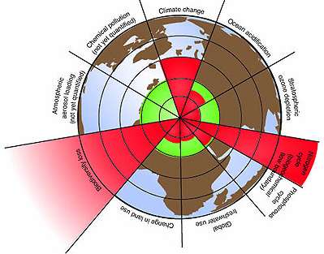
Planetary boundaries
10
Stockholm resilience center (link to their page if you click)
Quantified set of boundaries
“within which humanity can
continue to develop and thrive
for generations to come.”
“Crossing these boundaries
could generate abrupt or
irreversible environmental
changes.”
http://www.stockholmresilience.org/21/research/research-programmes/planetary-boundaries/planetary-boundaries/about-the-research/the-nine-planetary-boundaries.html

Slide 11
Explanation
11
Change in land use and Biodiversity loss
    Land use: Forests/wetlands→farming
    Biodiversity loss as a result
      Bees for pollination
      Bugs eaten by birds, eaten by
      mammals, eaten by larger mammals…
    We need to understand how and where our foods, clothes etc. are produced
http://www.stockholmresilience.org/21/research/research-programmes/planetary-boundaries/planetary-boundaries/about-the-research/the-nine-planetary-boundaries.html

Slide 12
Explanation
12
Global freshwater use
    Linked to climate change and change
    in land use
    We need to change our habits but also to
    prepare for a lack of water even where we have plenty today
http://www.stockholmresilience.org/21/research/research-programmes/planetary-boundaries/planetary-boundaries/about-the-research/the-nine-planetary-boundaries.html

Slide 13
Explanation
13
Nitrogen and phosphorous cycles
    Inputs to the biosphere and oceans
    We need to change our use of fertilizers
http://www.stockholmresilience.org/21/research/research-programmes/planetary-boundaries/planetary-boundaries/about-the-research/the-nine-planetary-boundaries.html

Slide 14
Explanation
14
Stratospheric ozone depletion
    Seems to be ok at the moment
    Our change of habits gave a good result
http://www.stockholmresilience.org/21/research/research-programmes/planetary-boundaries/planetary-boundaries/about-the-research/the-nine-planetary-boundaries.html

Slide 15
Explanation
15
Climate change/ Ocean acidification
    Increased CO2 → more acidic oceans
    We need to change our habits
http://www.stockholmresilience.org/21/research/research-programmes/planetary-boundaries/planetary-boundaries/about-the-research/the-nine-planetary-boundaries.html

Slide 16
Explanation
16
Atmospheric aerosol loading and Chemical pollution
Not yet quantified
    Aerosols: cloud forming, air pollution
    Chemicals: too many out of control of
    what they cause
    More research needed.
    But once we have the knowledge – is there still time to make changes?
http://www.stockholmresilience.org/21/research/research-programmes/planetary-boundaries/planetary-boundaries/about-the-research/the-nine-planetary-boundaries.html

Slide 17
Example: Chemical pollution
17
  In year 2011 there were 12000 new chemicals registered in CAS (Chemical Abstract Service - patented) every day (most never leaves the laboratories but still..)
  REACH
    Substitution principle – change chemical when possible
    Precautionary principle – don’t use a new chemical with risk of similar negative affects as the already known chemicals
  Great ideas - not strong enough, slowly implemented, and legislators are pushed hard by the chemical industry to slow down
  You have to inform yourself:
  Food (don’t understand the list of ingredients? Look for a substitute!)
  Toys (legislation more strict after 2007 and 2013 = don’t keep old plastic toys)
  Clothes (~8 000 liters of water and 1 kg of chemicals for one pair of jeans)

Slide 18
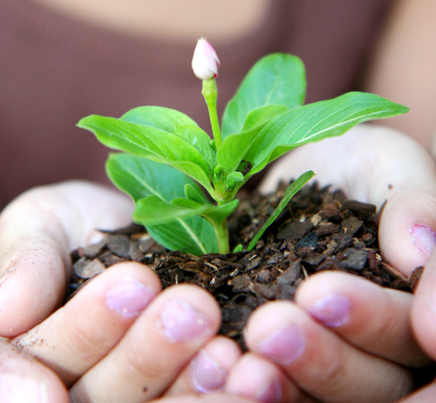
My own company
18
Aims to inspire for having homes, kindergartens, schools with less potentially toxic substances both indoors and outdoors
”The product” here is the list on making your own ”status” and a step-by-step guide on how to reduce the level of
potentially toxic substances in your
home/ at the kindergarten etc.
Recommend environmentally friendly
alternatives of different categories.
Such as: paint, toys, storage containers
(for drink and food - containers made of
stainless steel)

Slide 19
Thank you for your attention!
19
Questions?
    Studies
    Work
      Contaminated land
      Water
      WSP
    Planetary bounds
    Chemical pollution
    Other questions?
http://www.stockholmresilience.org/21/research/research-programmes/planetary-boundaries/planetary-boundaries/about-the-research/the-nine-planetary-boundaries.html

