Slide 1
Environmental Status
1
Positive and negative environmental aspects in your daily life
Positive examples
Recycle, reuse (things and clothes etc.)
Grow my own food
Buy organic and/or locally produced produce,
Take short showers, turn the light off in rooms I'm not in
Bike/walk
Negative examples
Throw away edible foods
Take long showers
Take the car everywhere (ask for a ride, when I can bike/walk)

Slide 2
Environmental self esteem
2
Think! Where are you today?
Write down 5-10 positive aspects
Every positive aspect is good!
Write down 5-10 negative aspects/ aspects of improvement
Negative aspects mean you have potential ;-)
The total of what you achieve gives you your:
Environmental Status
You should be proud of what you do! Boost your environmental self esteem!

Slide 3
Enlarge your environmental comfort zone
3
What you do today is possibly also within your environmental comfort zone
Would you be willing to take a small step to enlarge your environmental comfort zone?
Which is your area of motivation?
Think once more before I buy something?
Buy less (clothes, shoes, electronics etc.)
Stop asking for a ride when I can bike/walk (or at least during spring and summer months)
Write a list of 3 top priority steps
Make sure to envision and take small steps! Then you’re more likely to achieve them and thus to keep you’re environmental self esteem boosted

Slide 4
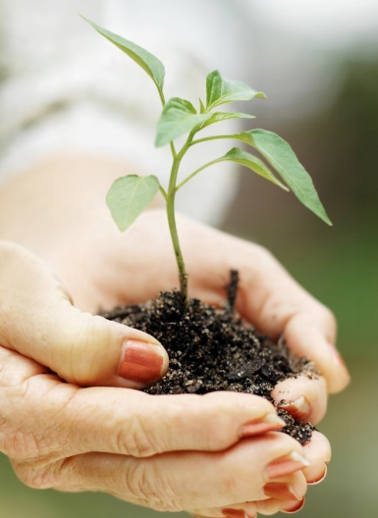
Finally
4
Environmental status
Only small steps at a time
Find your area of motivation and start there
Maybe your first step is to engage a friend to take a step you’ve already taken?
No one can make change but you!

